Slide 1
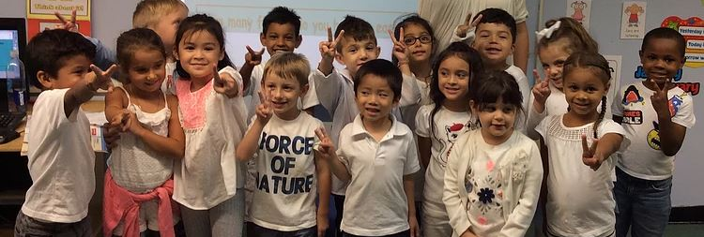

help support and enrich our children’s education!
The PS99 Parents’ Association is a voluntary association of parents. Through our sponsorship of additional events, activities, learning programs and classroom items, we aim to encourage our children’s love of learning and foster a sense of community among our families. We hope that you’ll participate!
YOUR HELP MAKES IT HAPPEN. Become a contributing member of the PS99 Parents’ Association. While there is no cost to join, your voluntary financial contribution to the Parents’ Association School Fund makes our sponsorship of these activities possible.
The suggested donation is $30.00 per family, and if you’re able, we hope you will donate more – but every donation makes a difference regardless of the dollar amount!
YOUR DOLLARS AT WORK. All donations support goods and services for our children. Here are just a few of the items your support has funded:
Dyslexia Awareness Training
Literacy Benchmarking Tool Kits
Hydroponic Gardening Kits for our Second Graders
Our Phone Messaging System
A New Digital Clock for the Annex Gym
Play Puppet Theatre for our Kindergartners
Athletic Jerseys for the Basketball Team
Events including the Holiday Party, World Fest and the Teacher Appreciation Brunch
And much more…
---------------------------------------------------------------------------------------------------------------------------------------------------
We thank you for your support! Please return this tear off along with your donation before November 16.
Student Name ________________________________________ Class # ________________________ Parent/Guardian’s Name________________________________ Signature________________________ Phone# _____________________________ E-mail____________________________________________ Donation: $30_____ $50______ other $____________ Please make checks or money orders payable to Parents’ Association P.S.99Q. You may also donate in person at Parent Teacher Conferences on Thursday, November 16. Want to donate your time? Sign up to volunteer at one of our events: https://ps99parents.org/volunteer/

